Slide 1
My schoolbag
– biggeners’ 1 –
b.1 l.1 vocab

Slide 2
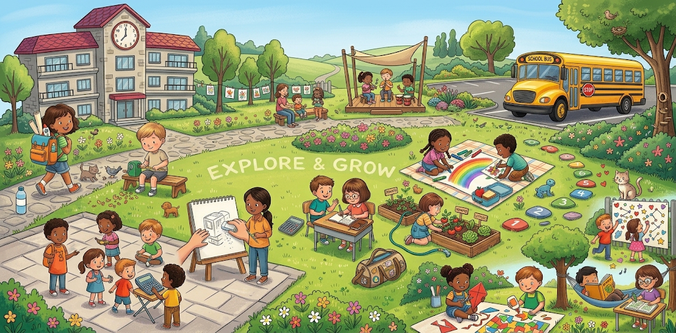

Slide 3
Awesome words

Slide 4
01
Nouns

Slide 5
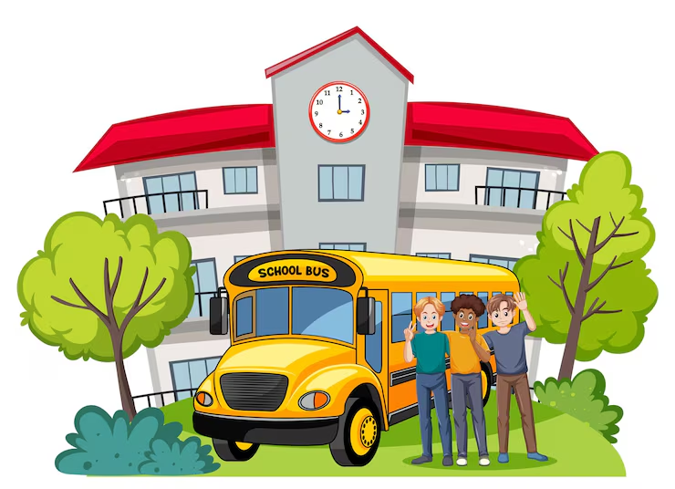
School
I go to school everyday.

Slide 6

Pencil
I use my pencil to write.

Slide 7

Pen
My pen is blue.

Slide 8

Eraser
I erase with my eraser.

Slide 9
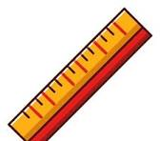
Ruler
I have a ruler in my pencil case.

Slide 10

Book
I read my book.

Slide 11

Sharpener
I have a sharpener in my pencil case

Slide 12
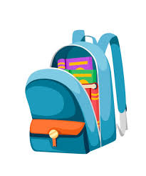
Backpack
My backpack is red.

Slide 13

Crayons
I color with crayons.

Slide 14

Scissors
I cut the paper with the scissors.

Slide 15

Glue
I stick the papers with a glue.

Slide 16

Highlighter
The highlighter is yellow.

Slide 17
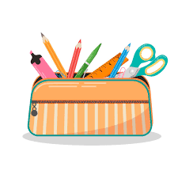
Pencil case
My pencil case is colorful.

Slide 18
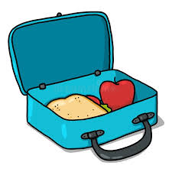
Lunch box
I have food in my lunchbox.

Slide 19
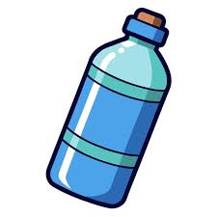
Water bottle
I have a water bottle in my bag.

Slide 20
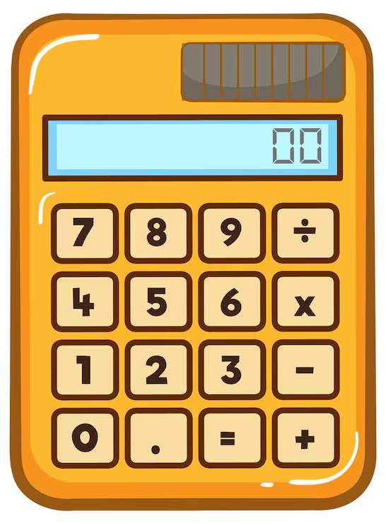
Calculator
I use calculator to solve math problems.

Slide 21
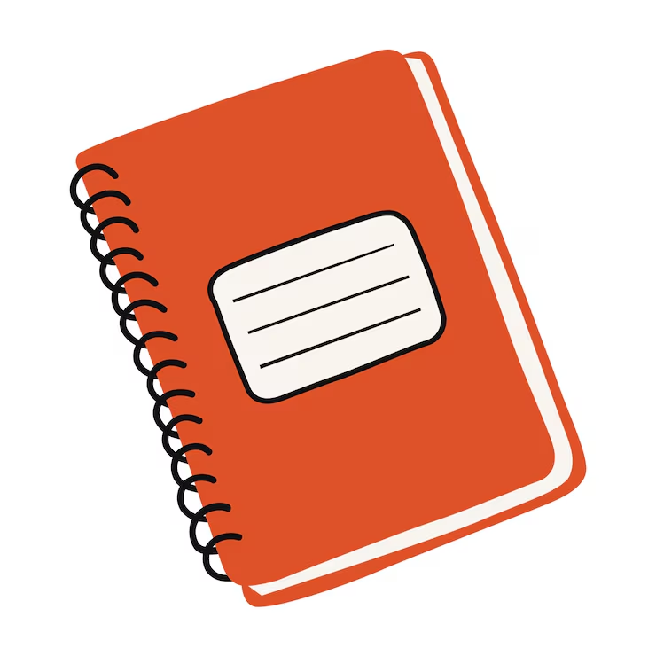
Notebook
I write my homework in my notebook.

Slide 22
Verbs
02

Slide 23
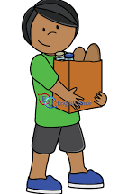
Carry
I carry the box.

Slide 24
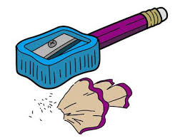
Sharpen
I sharpen my pencil.

Slide 25
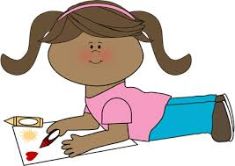
Color
I color with my crayon.

Slide 26

Write
I write with my pencil.

Slide 27
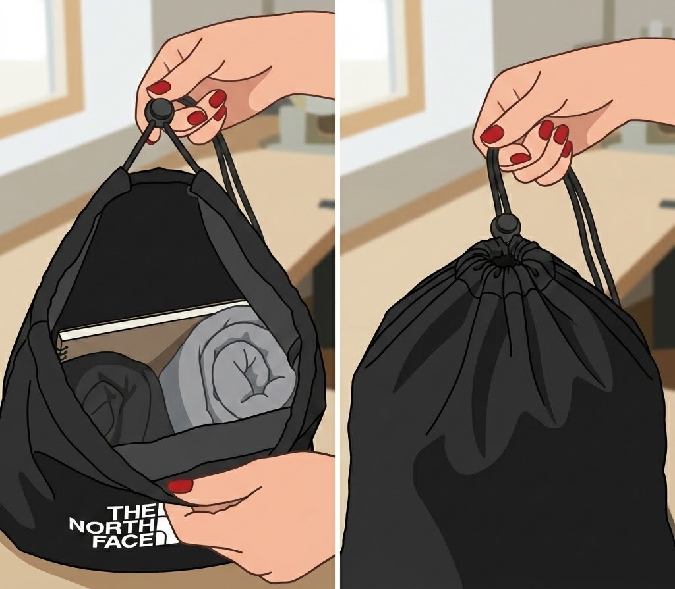
Open and close
I open and close the bag.

Slide 28
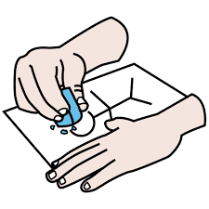
Erase
I erase with an eraser.

Slide 29
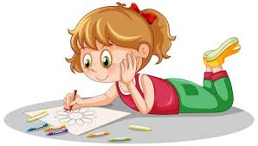
Draw
I like to draw.

Slide 30
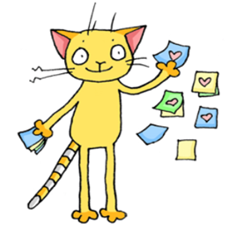
Stick
I stick a sticker to the wall.

Slide 31
Adjectives
03

Slide 32
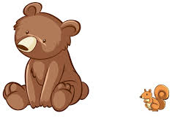
Big
The bear is big.

Slide 33
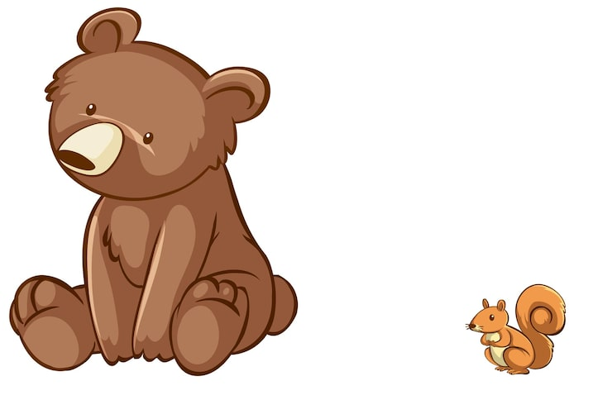
Small
The squirrel is small.

Slide 34

Colorful
My pencil case is colorful.

Slide 35
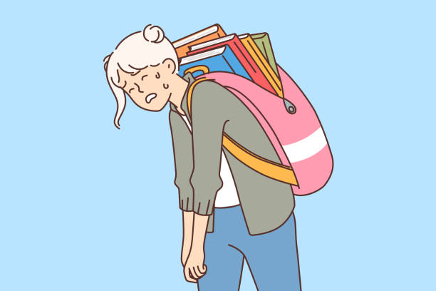
heavy
My bag is heavy

Slide 36
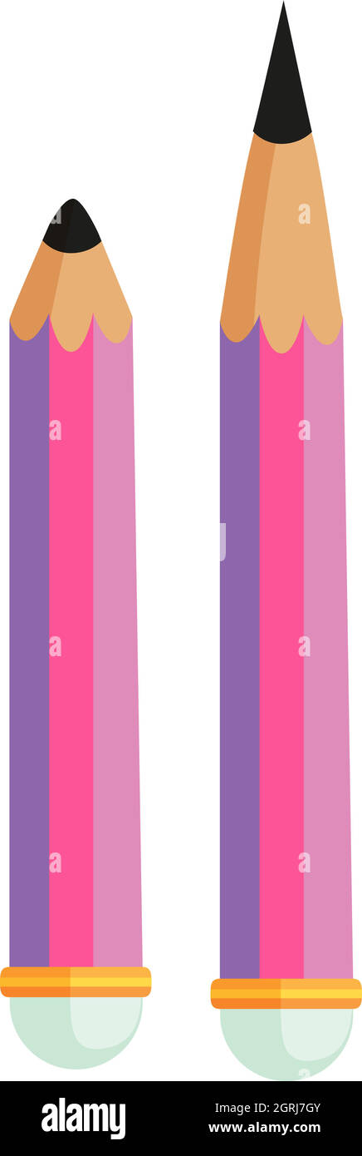
dull
My pencil is dull

Slide 37
sharp
My pencil is sharp

Slide 38
Reading task

Slide 39
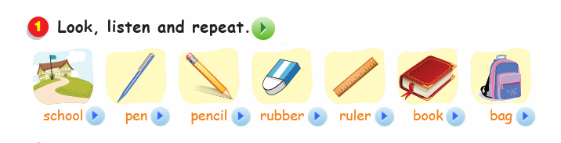


Slide 40
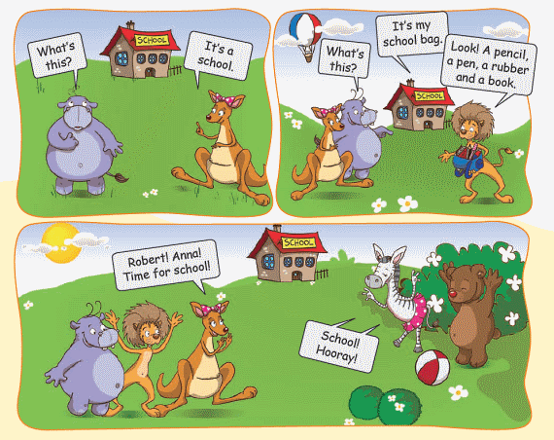

Slide 41
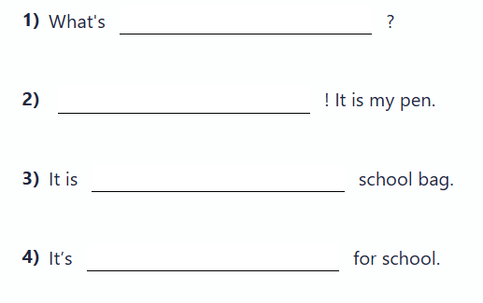

Slide 42
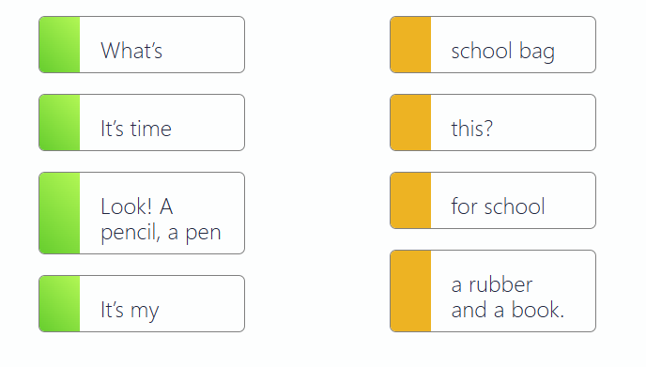

Slide 43
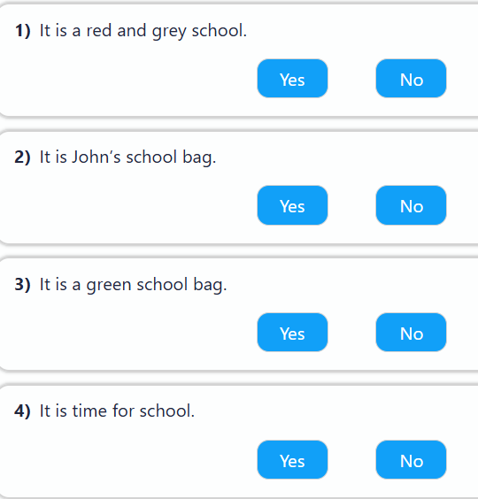

Slide 44
Thanks!

