Slide 1
My schoolbag
– biggeners’ 1 –
b.1 l.1 speaking tasks

Slide 2
Speaking task

Slide 3

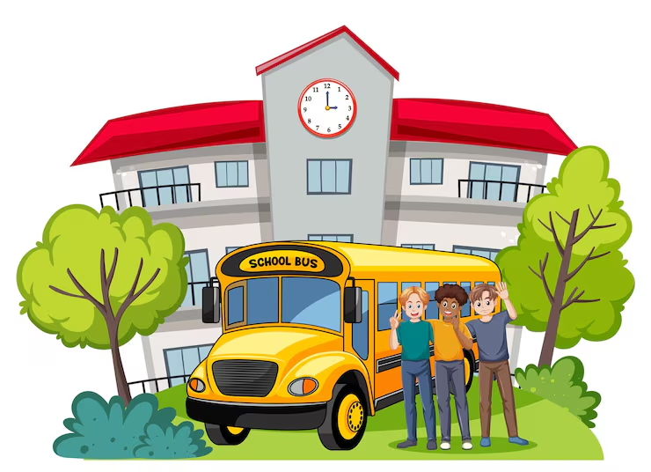

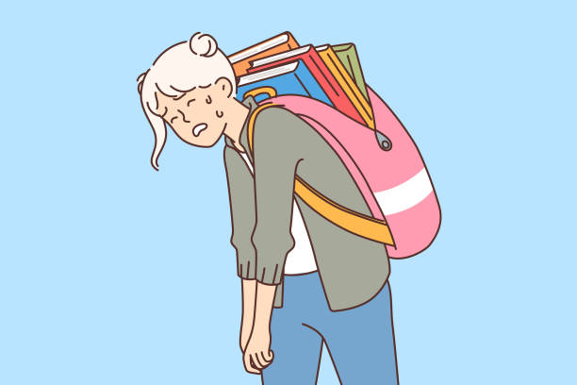
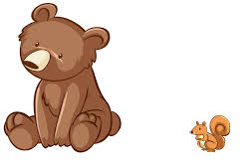
At ......, I ....... my ....... ...........

Slide 4

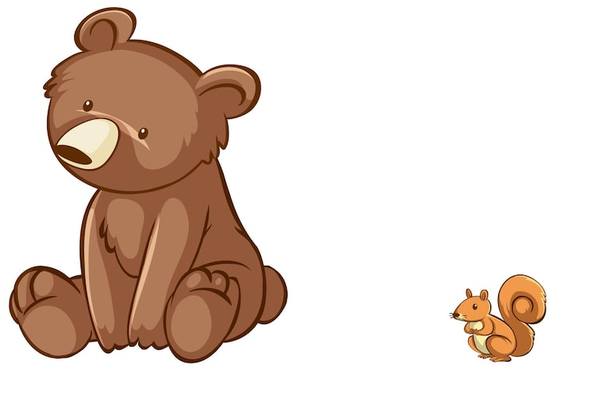



I have a ......, a......., a........ and a ........ ...........

Slide 5



I ....... and ......... with my ..........

Slide 6


I ........ with my …………

Slide 7



I use a ....... to ......... my ...... …....

Slide 8
Now my ........ is …………..

Slide 9



I love to cut the papers with the ……… then ………. with ……….

Slide 10


I have a ......... in my ............

Slide 11




I have a ........ .......... and a ............. ............

Slide 12
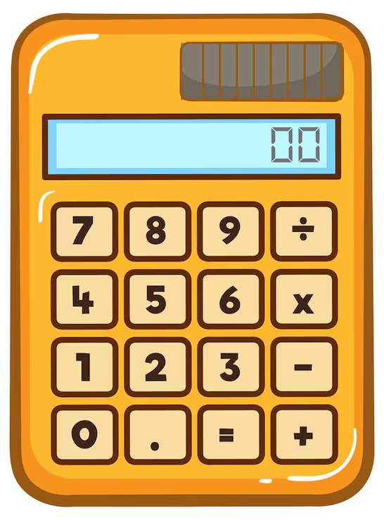
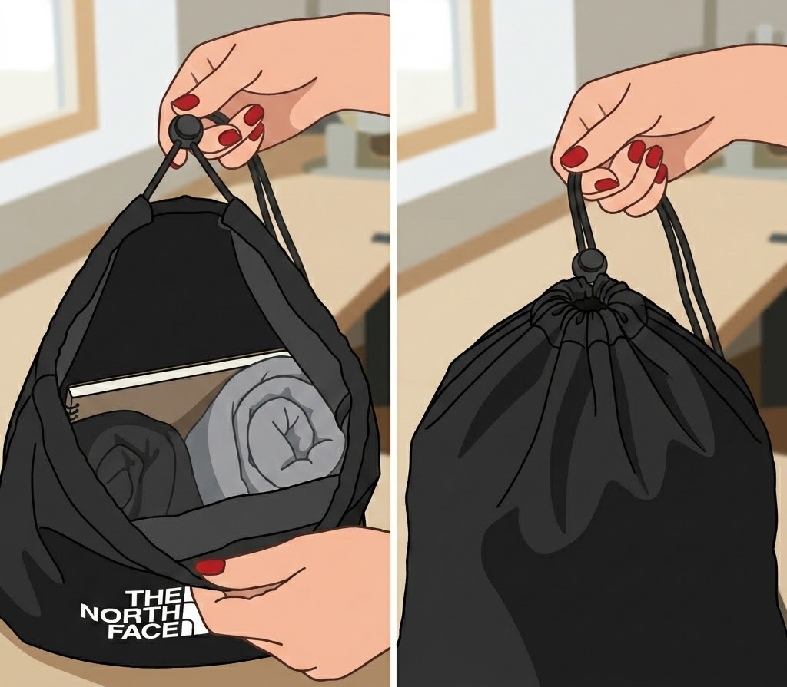

When I …….my bag I find …..and ….

Slide 13
After I finish school I …… my bag

Slide 14
Thanks!

